Slide 1
Liberi. – Design Process
Alex Maslarski

Slide 2
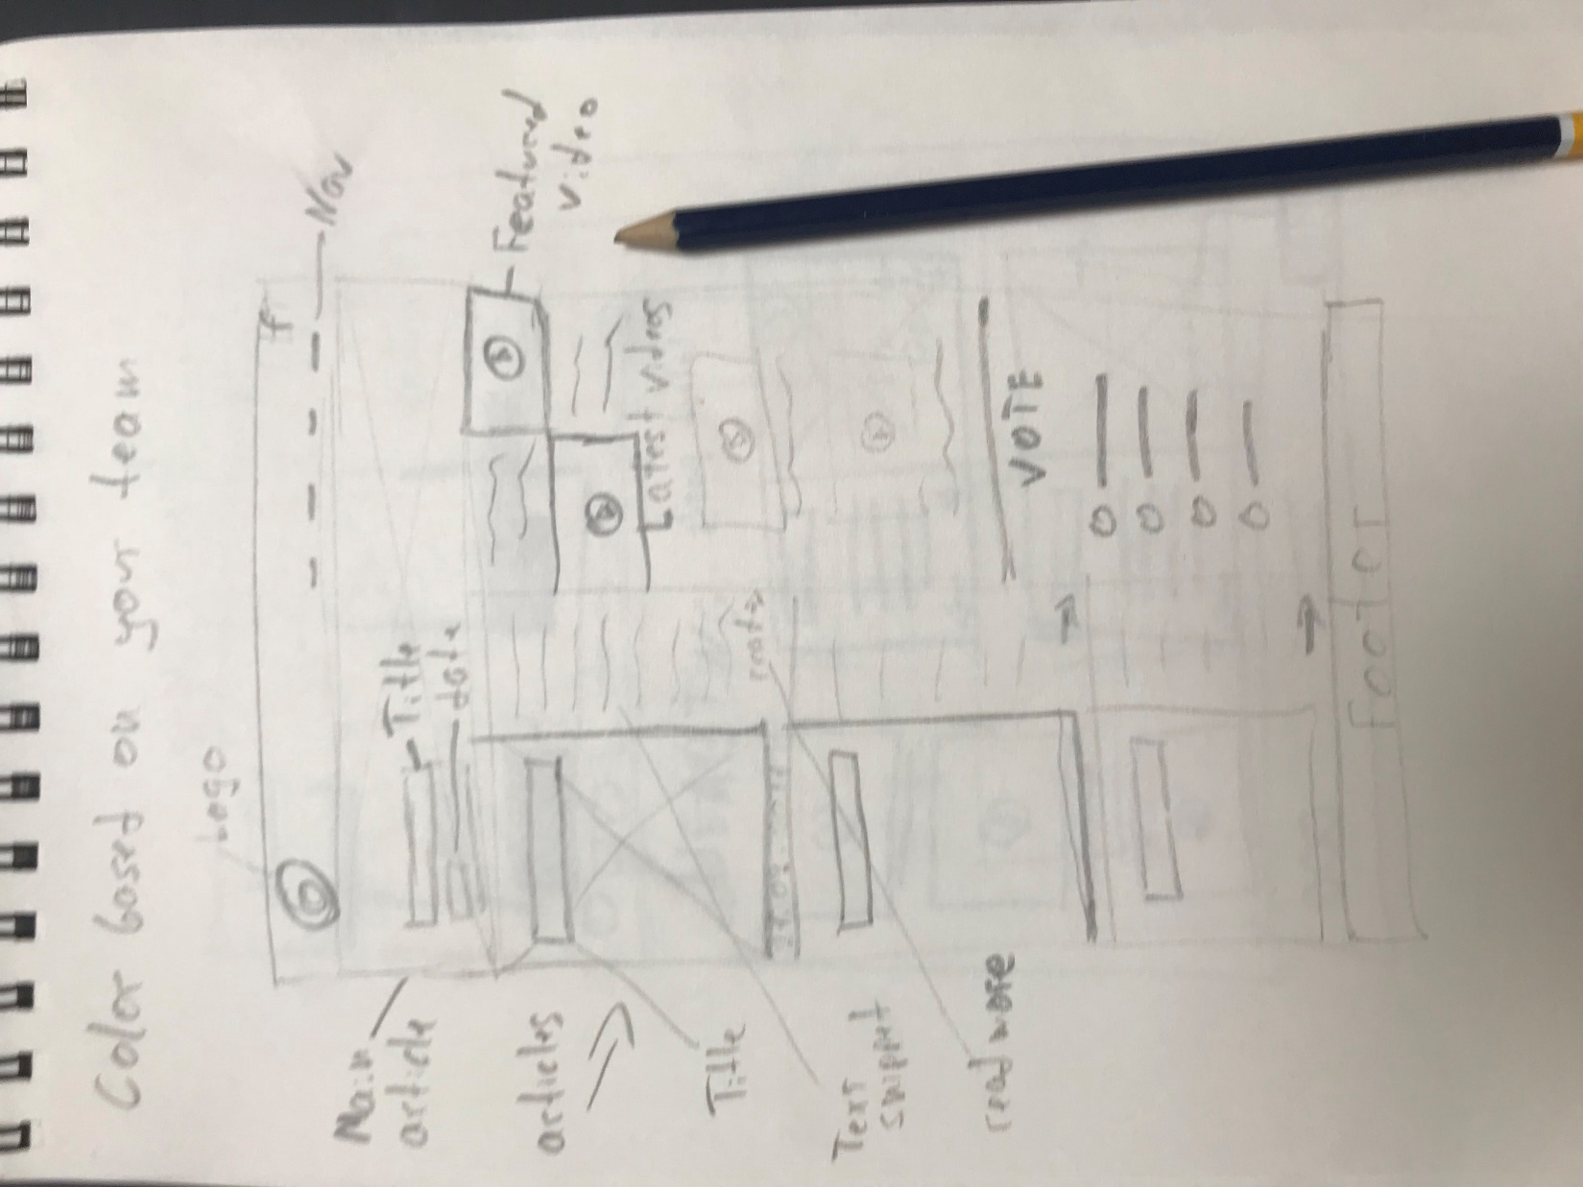
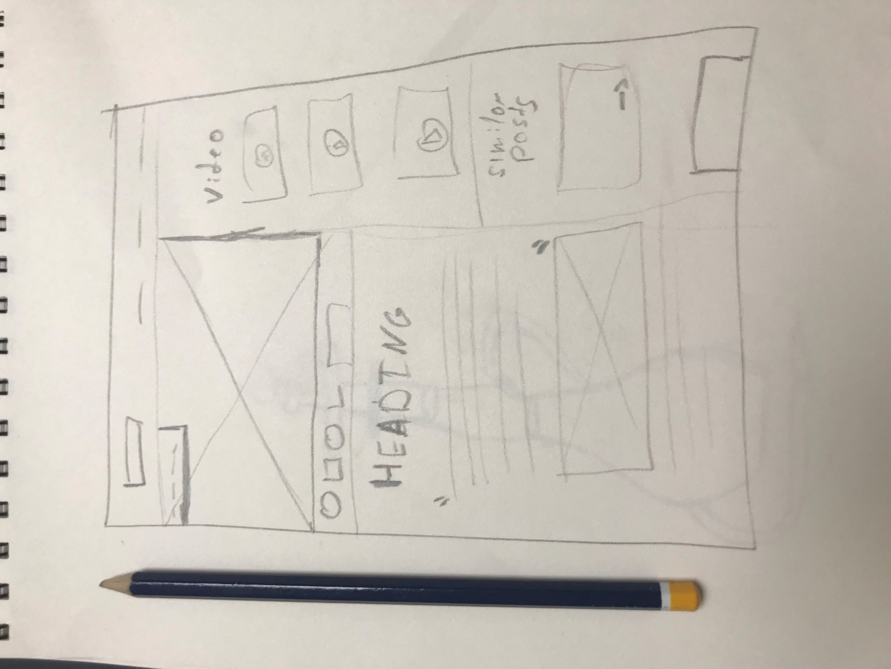
The sketches

Slide 3
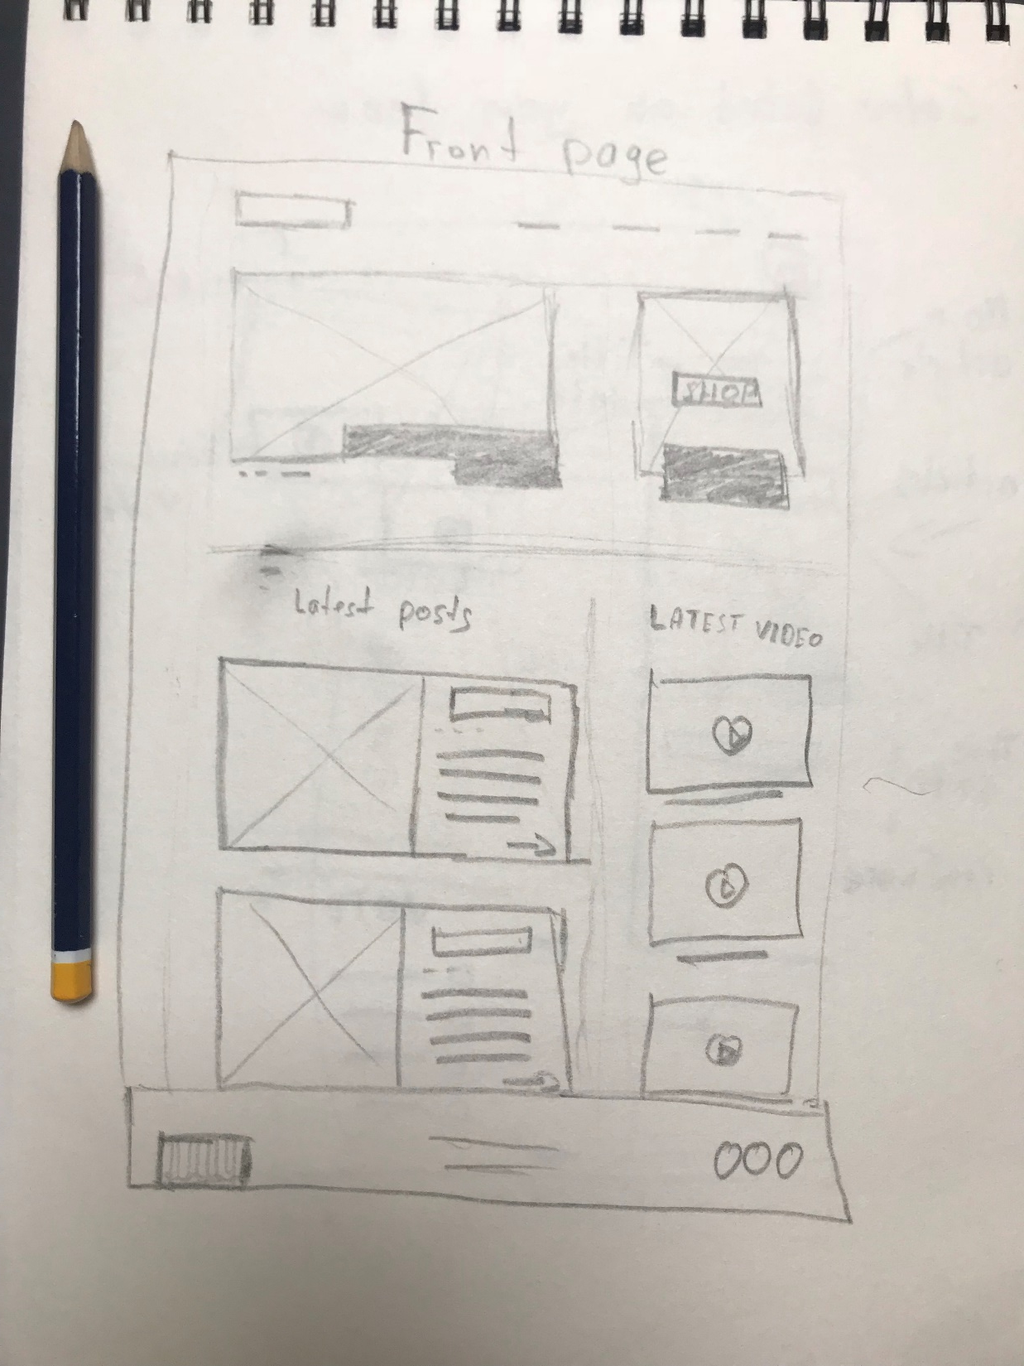
Final Sketch
The main page sketch. It includes two main sections who are devided in two columns. The first section is the Featured article and shop cards. the second section includes the latest posts and latest video put on the right side.

Slide 4
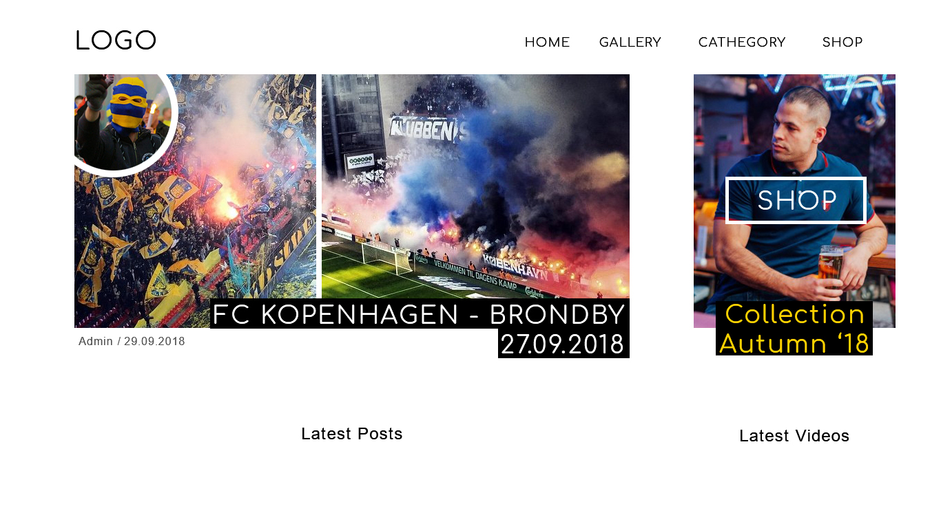
Mockups
The first mockup is based on the final sketch. I made the rough layout of how the page should look like and I gave myself some space and opportunity to improve it and change it a little bit afterwards.

Slide 5
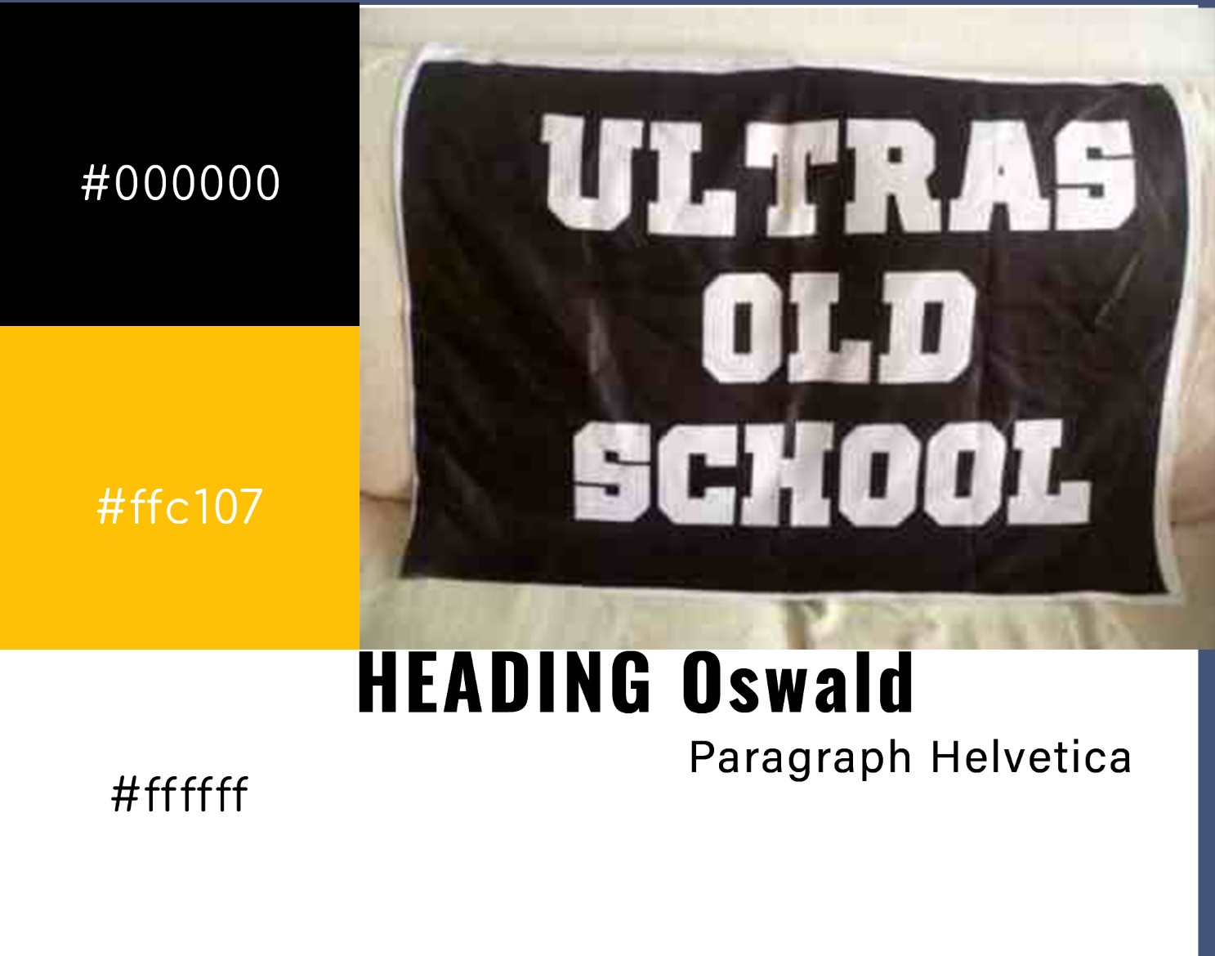
Moodboard and design decisions
The main idea was that the website had neutral colors. Football fans are known of protecting their colors and hating the opponent’s colors, that’s why I decided to make the website black and white with yellow-orange as an accent color. For example if I used blue, all fans whose teams were with blue would like the site, but fans whose rival team is blue would hate the site. So that’s why it was important to be neutral. Also most of the football fans have black&white flags and I wanted the design to somehow imitate an old school flag while still being modern and easy to use and navigate.
I decided to use a bold font as it is more harsh and shows strength and power.

Slide 6
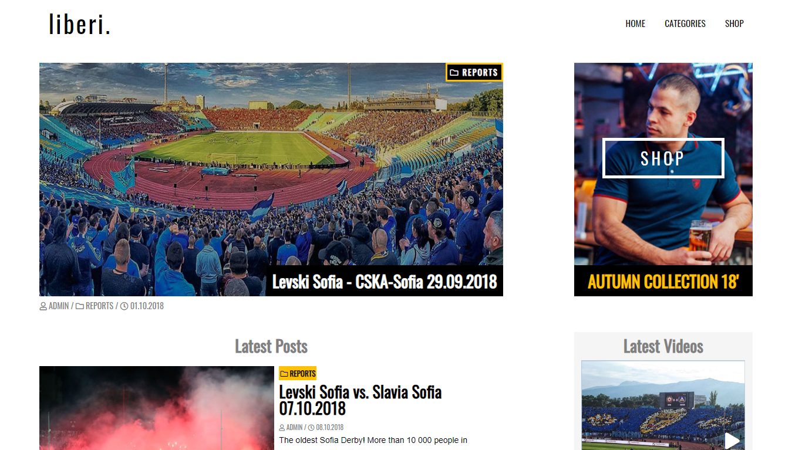
The final design
This is how the website turned out looking like in the final design. As always I like to not be strict with the mockup when building a website. I change some of the elements to make sure they look good in a browser. Though I follow the rough guidelines of the mockups, I decided that certain things would look better in a slightly different way.

Slide 7
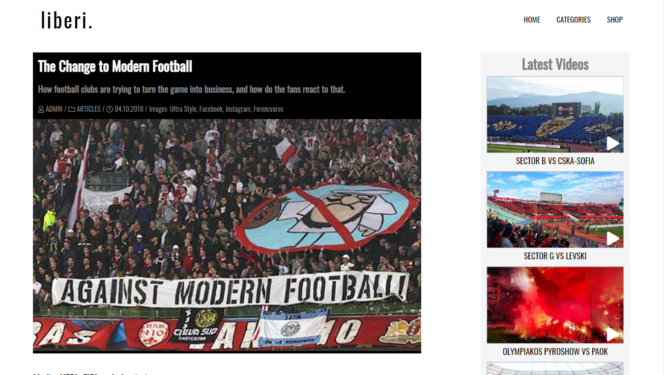
This is the final look of every article. I decided to make all the main info stand out using a black background.

